Slide 1
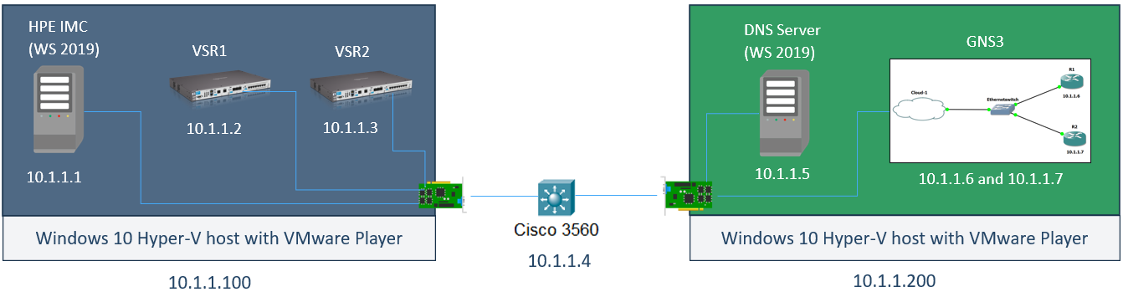
Virtualization and networking
Lecture 7
SoftUni Team
Technical Trainers
Software University
http://softuni.bg

Slide 2
Table of Contents
Virtualization and networking
Network management systems
Demonstration

Slide 3
Virtualization and networking

Slide 4
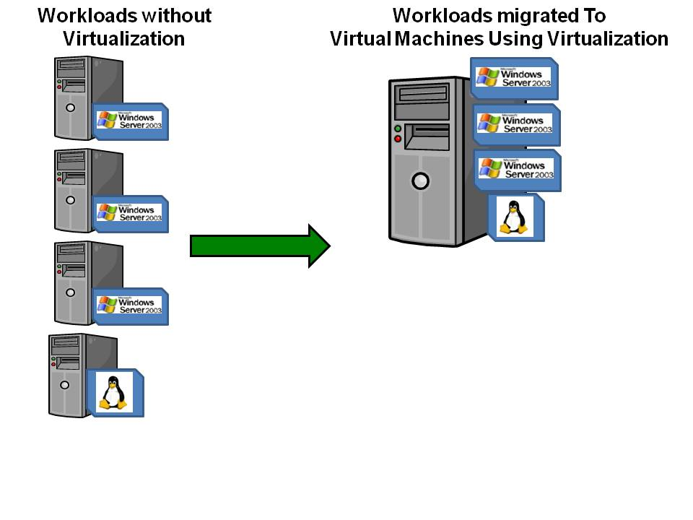
Why virtualization?
You get the most out of your server hardware
Easier configuration, for redundancy and backup
Simplified management
Fast provisioning of new machines
Saves energy and costs

Slide 5
Types of virtualization
OS virtualization
Application virtualization
Network virtualization
Storage virtualization
Others…

Slide 6
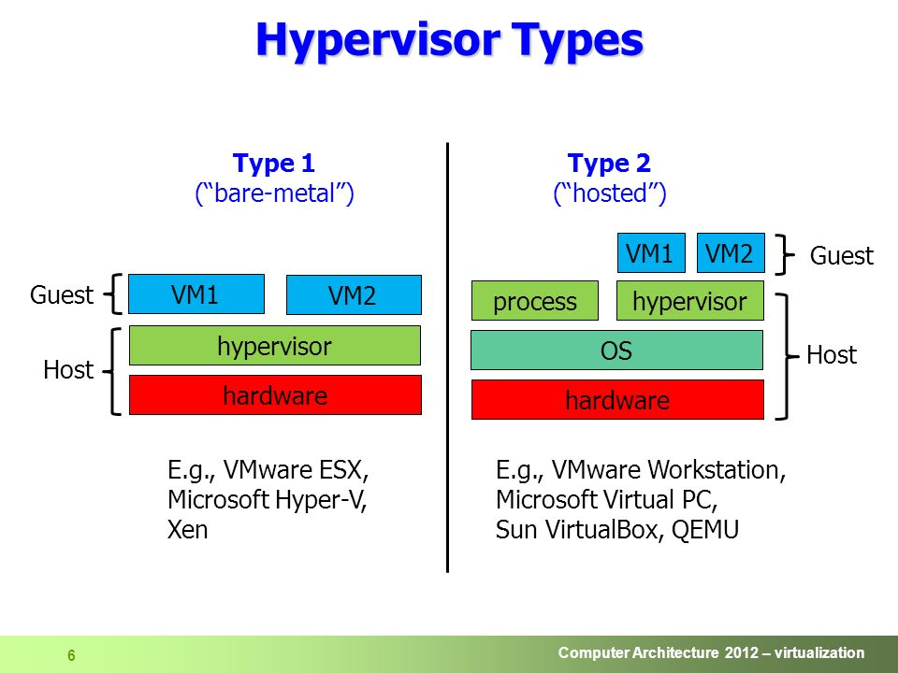
OS virtualization types

Slide 7
Hyper-V and virtual networks
In Hyper-V, when you create a new network, you create a new virtual switch
You can create different types of networking (switches), depending on your needs:
Private
Internal
External

Slide 8
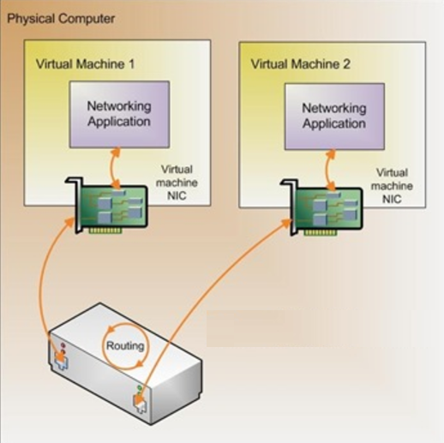
Hyper-V private network
Provides VM to VM connectivity only
No external communication
No communication with the host
Private network

Slide 9
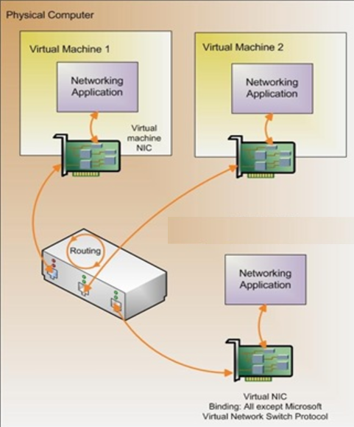
Hyper-V internal network
Provides VM to VM connectivity
Also provides communication with the host
No external communication
Internal network

Slide 10
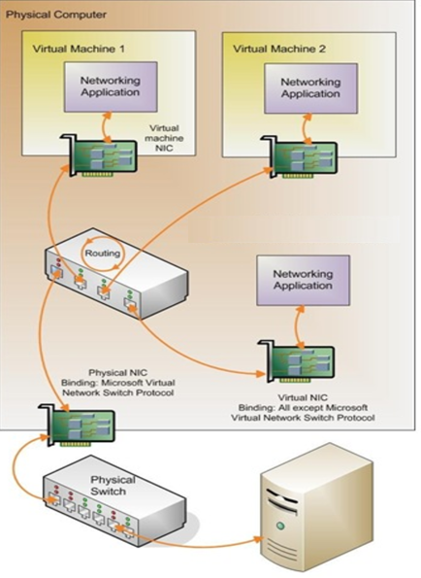
Hyper-V external network
Provides VM to VM connectivity
Provides communication with the host
Provides external communication
External network

Slide 11
Network management systems

Slide 12
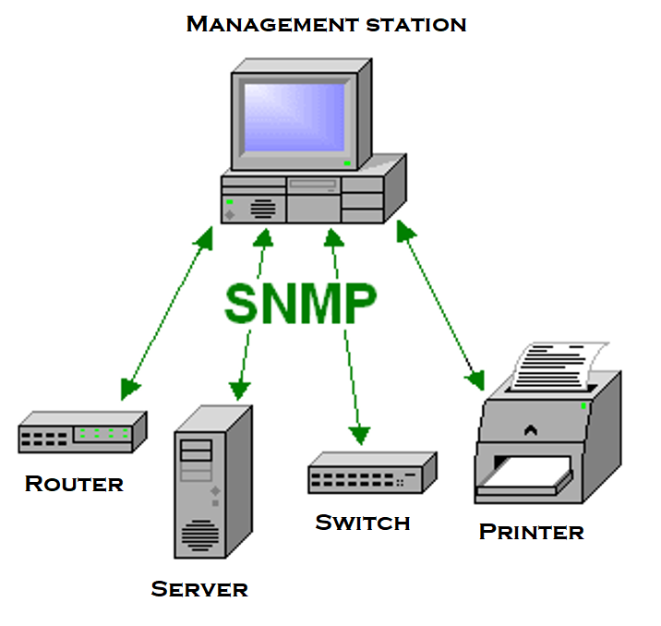
What is a network management system?
A central “hub” to monitor and manage multiple devices
Advantages:
Easy to manage your network
Saves time
Cost effective
Decreases downtime
…more?

Slide 13
NMS and protocols
Quite often network management systems use these common protocols (any combination of them) to access the devices:
Simple Network Management Protocol (SNMP)
Telnet
SSH

Slide 14
Network management
SNMP overview

Slide 15
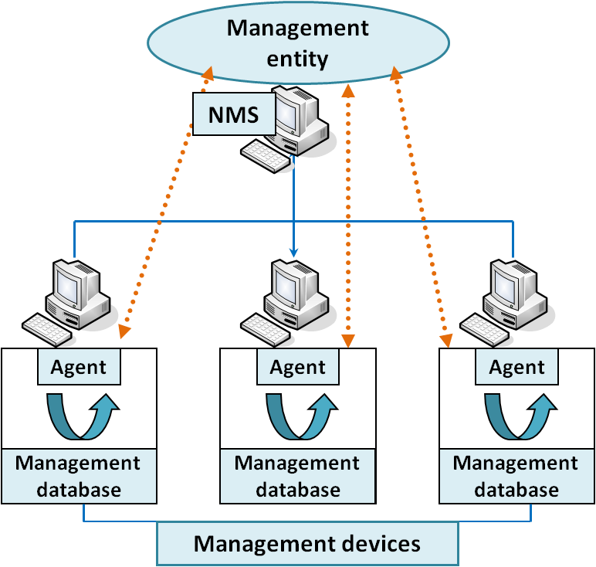
SNMP components
Agent
Management station (NMS)
SNMP messages
Management information base (MIB)

Slide 16
SNMP message types
Get - Read only
Set - Read/Write
Trap - generated by the agent

Slide 17
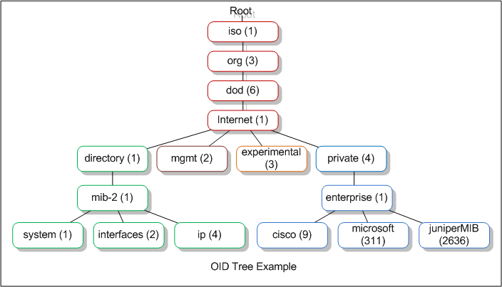
SNMP MIB
MIB: Management Information Base
Collection of information organized hierarchically
Each entry in MIB is addressed through OID (object ID)
MIB structure must be known by the NMS and the agents

Slide 18
SNMP versions
SNMP v1
poor security
not very good performance
SNMP v2c
poor security
better performance
SNMP v3
Secure and with good performance
More difficult to configure

Slide 19
Demonstration

Slide 20

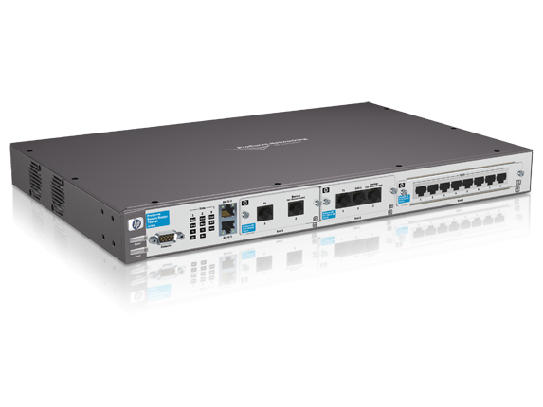
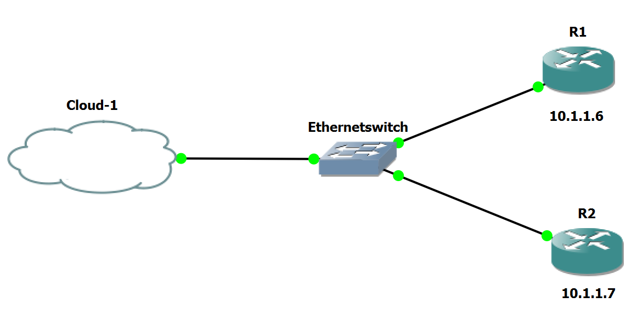

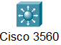
HPE IMC
(WS 2019)
DNS Server
(WS 2019)
VSR1
VSR2
GNS3
10.1.1.2
10.1.1.3
10.1.1.1
10.1.1.5
10.1.1.6 and 10.1.1.7
Windows 10 Hyper-V host with VMware Player
Windows 10 Hyper-V host with VMware Player
10.1.1.4
10.1.1.100
10.1.1.200

Slide 21

Summary
Virtualization and networking
Network management systems
Demonstration
…
…
…

Slide 23



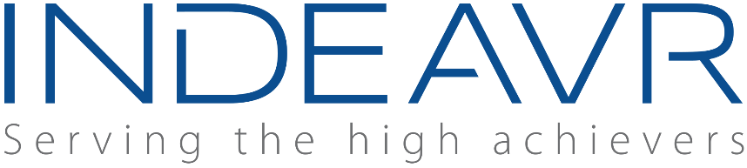








SoftUni Diamond Partners

Slide 24
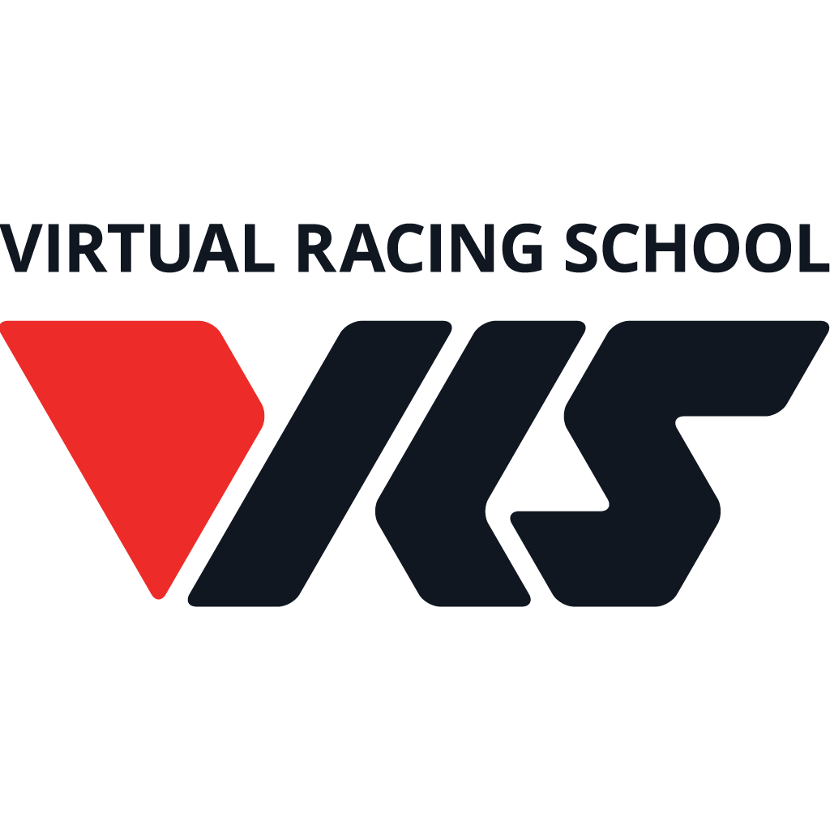

Educational Partners

Slide 25
Trainings @ Software University (SoftUni)
Software University – High-Quality Education, Profession and Job for Software Developers
softuni.bg, about.softuni.bg
Software University Foundation
softuni.foundation
Software University @ Facebook
facebook.com/SoftwareUniversity
Software University Forums
forum.softuni.bg
Notes:
25

